Slide 1


MINUTE MAID
Client Communication Plan
Notes:
Restyled from the supplied BCOM Presentation 3.pdf. Original slide 1.

Slide 2


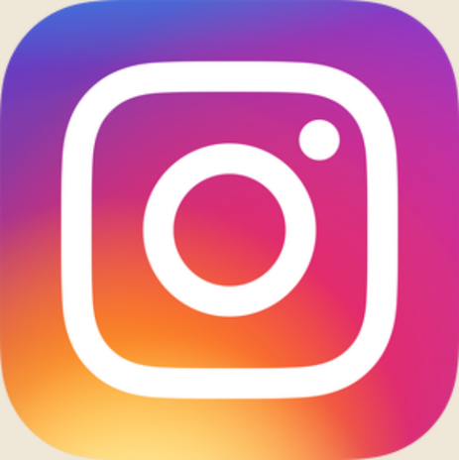

SOCIAL MEDIA
Notes:
hook “Think about the last time you bought a product because you saw it on TikTok or Instagram.
Maybe it was a drink, skincare product, or something an influencer recommended. Now think about the last time you saw Minute Maid on your feed.”
Transition: “That’s the problem. Minute Maid is a recognizable brand, but recognition alone isn't enough to stay relevant with younger consumers."

Slide 3
AGENDA
01
Communication challenge
05
Recommendation
02
Consumers
06
Timeline & Budget
03
Communication gap
07
Key performance indicators
04
Social media
08
Conclusion
Abby
Notes:
Restyled from the supplied BCOM Presentation 3.pdf. Original slide 3.

Slide 4
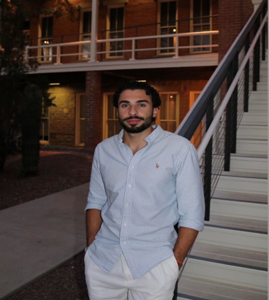
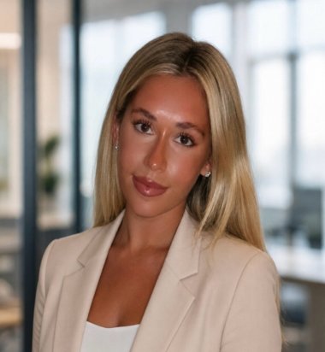
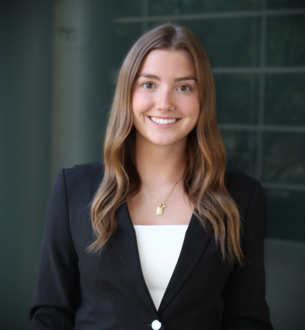
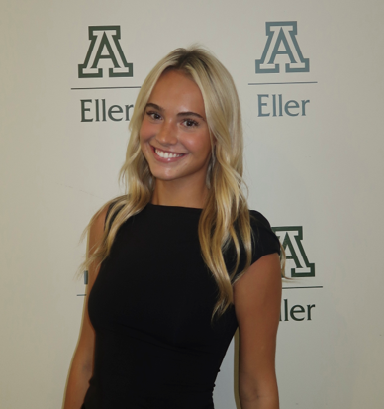
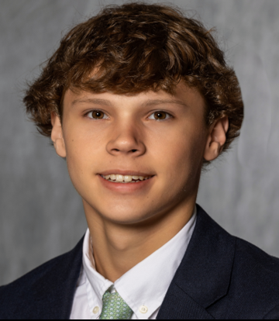
TEAM 29
Ramzi Charani
Lacey Klueber
Shelby Dahms
Abigail Reinders
Jay Schlosser
Notes:
Restyled from the supplied BCOM Presentation 3.pdf. Original slide 4.

Slide 5
COMMUNICATION CHALLENGE
Strong established brand, BUT...
Brand Consideration Ranking
Gen X
Baby Boomers
Gen Z
5th
8th
15th
Jay
Notes:
-Minute Maid has a communication gap
-Minute Maid's established brand equity may not be translating into the same relevance with younger consumers
-Younger consumers discover beverage trends differently
If younger consumers don't develop consideration for Minute Maid, the brand risks its strong heritage becoming familiarity without relevance
-Younger consumers are approaching the beverage market differently, and Minute Maid may not have the same relevance among them as it does among older generations.
-Top 10 among brand consideration % for both Gen X and Baby Boomer’s, outside the top 10 for Gen Z and there has been a steady decline over the generations in %

Slide 6
CONSUMER STAKEHOLDER
18–29
80% - 63%
Female Gen Z consumers
Use Instagram / TikTok
2 in 3
23%
Gen Z purchased functional beverages last year
Income spent on food and beverages
Shelby
Notes:
Minute Maid has an opportunity to better connect with Gen Z, specifically females ages 18 to 29, through social media.
According to Pew Research Center, 80% of Gen Z uses Instagram and 63% uses TikTok, showing how important social media is to this generation.
Gen Z also values wellness. McKinsey found that two-thirds of Gen Z and millennials purchased functional nutrition products last year. This shows that they want beverages that balance taste, enjoyment, and wellness. Food Dive also reports that Gen Z spends 23% of their income on food and beverages.
Our goal is to make Minute Maid feel more relevant and relatable to Gen Z and encourage them to engage with the brand on social media.
With over 100 flavors and varieties, including zero-sugar options, Minute Maid already has products that appeal to this generation. The opportunity is to communicate those products in ways that connect with Gen Z.

Slide 7
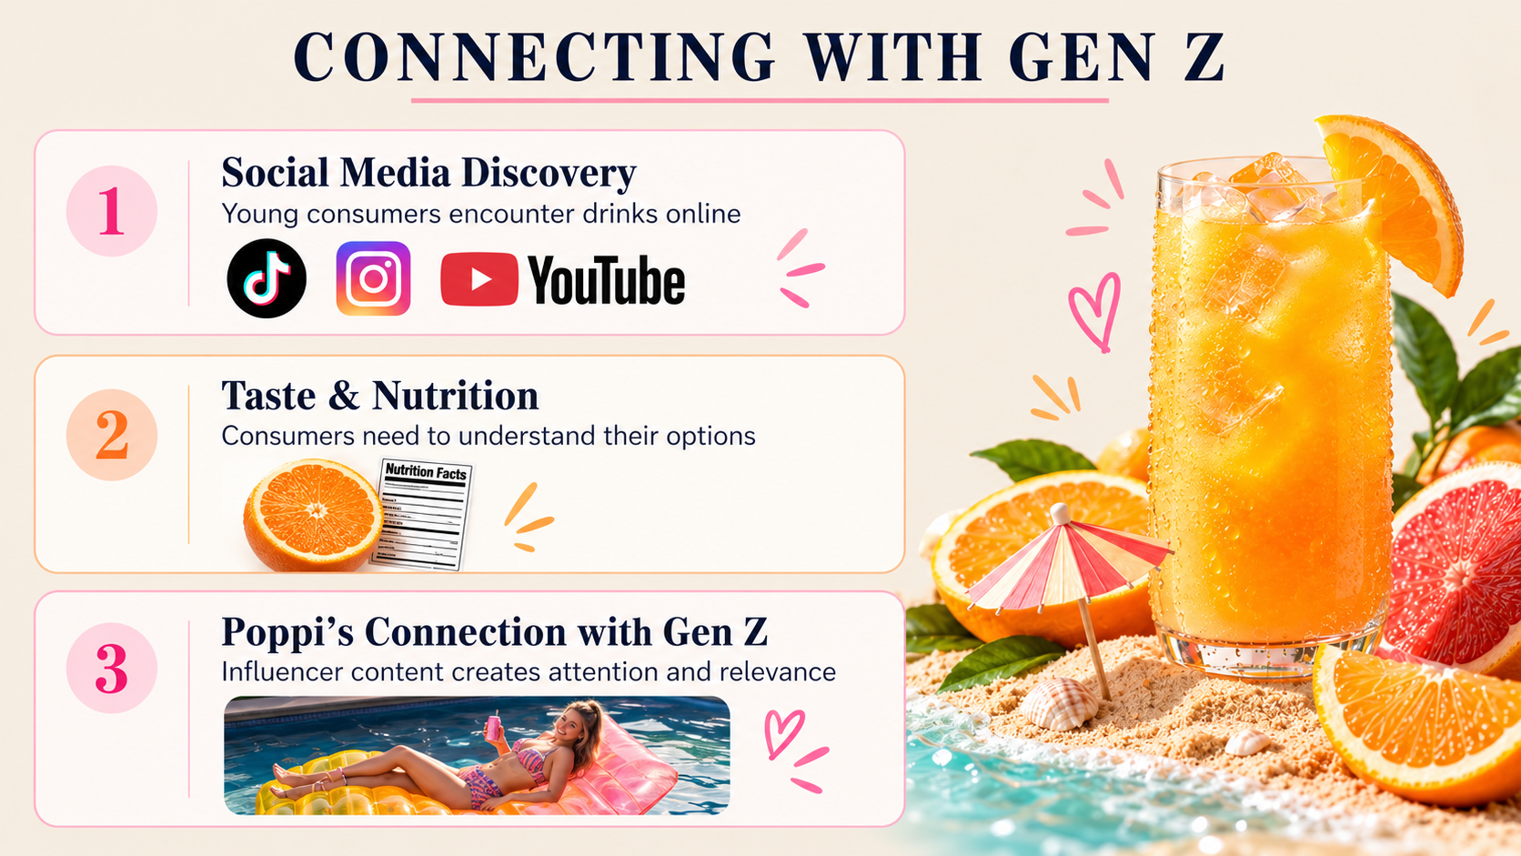
Ramzi
Notes:
Restyled from the supplied BCOM Presentation 3.pdf. Original slide 7.

Slide 8
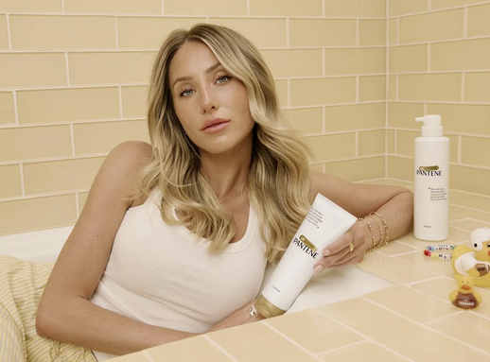
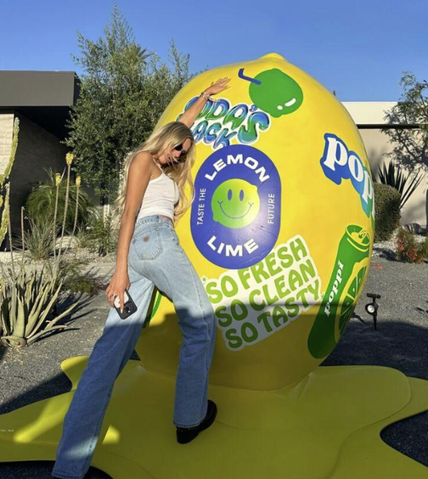
SOCIAL MEDIA: FORGOTTEN TO TRENDING
Pantene
Poppi at Coachella
+20%
7M+
230M+
+200%
50M+
20+
Sales lift for several bestsellers
Views on original TikTok
Reported campaign impressions
Reported sales spike during Coachella
Impressions in three days
Sponsored campaign videos
Lacey
Notes:
Restyled from the supplied BCOM Presentation 3.pdf. Original slide 8.
The campaign statistics are retained as reported in the supplied PDF. Original source URLs were not embedded on this page.

Slide 9
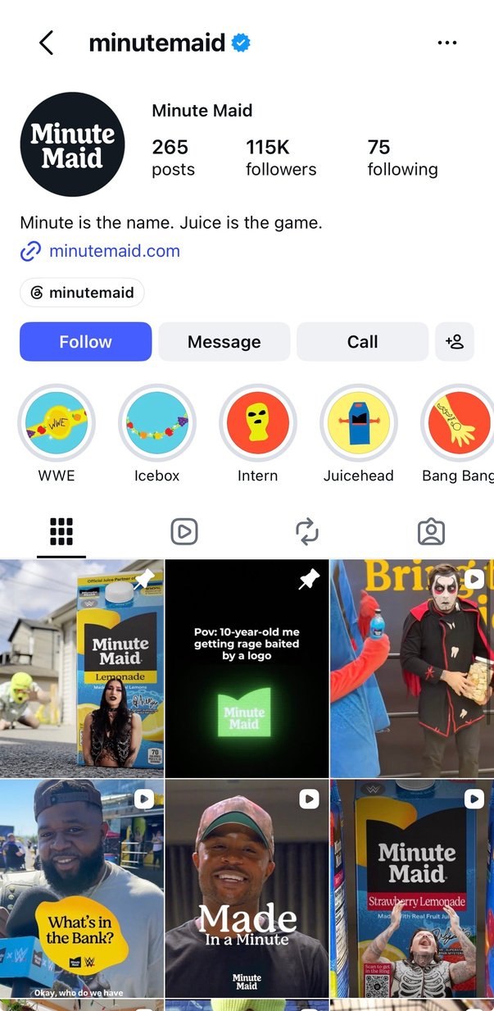
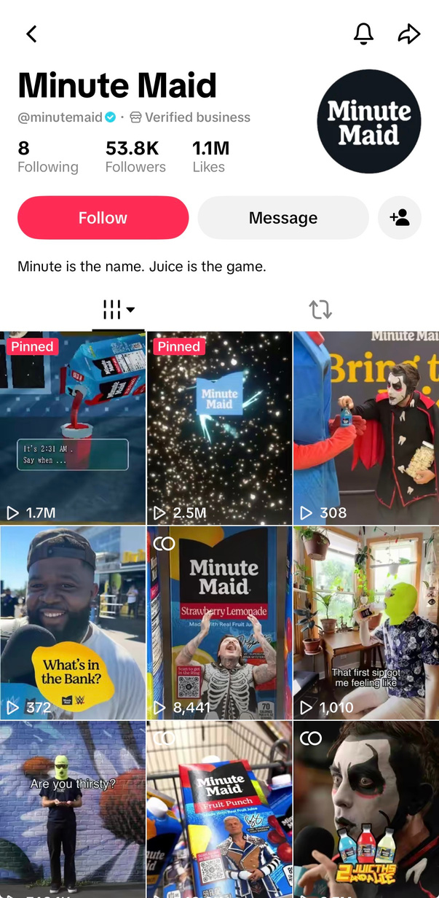
MINUTE MAID’S CURRENT SOCIAL MEDIA PRESENCE
Lacey
Minute Maid Instagram
Minute Maid TikTok

Slide 10
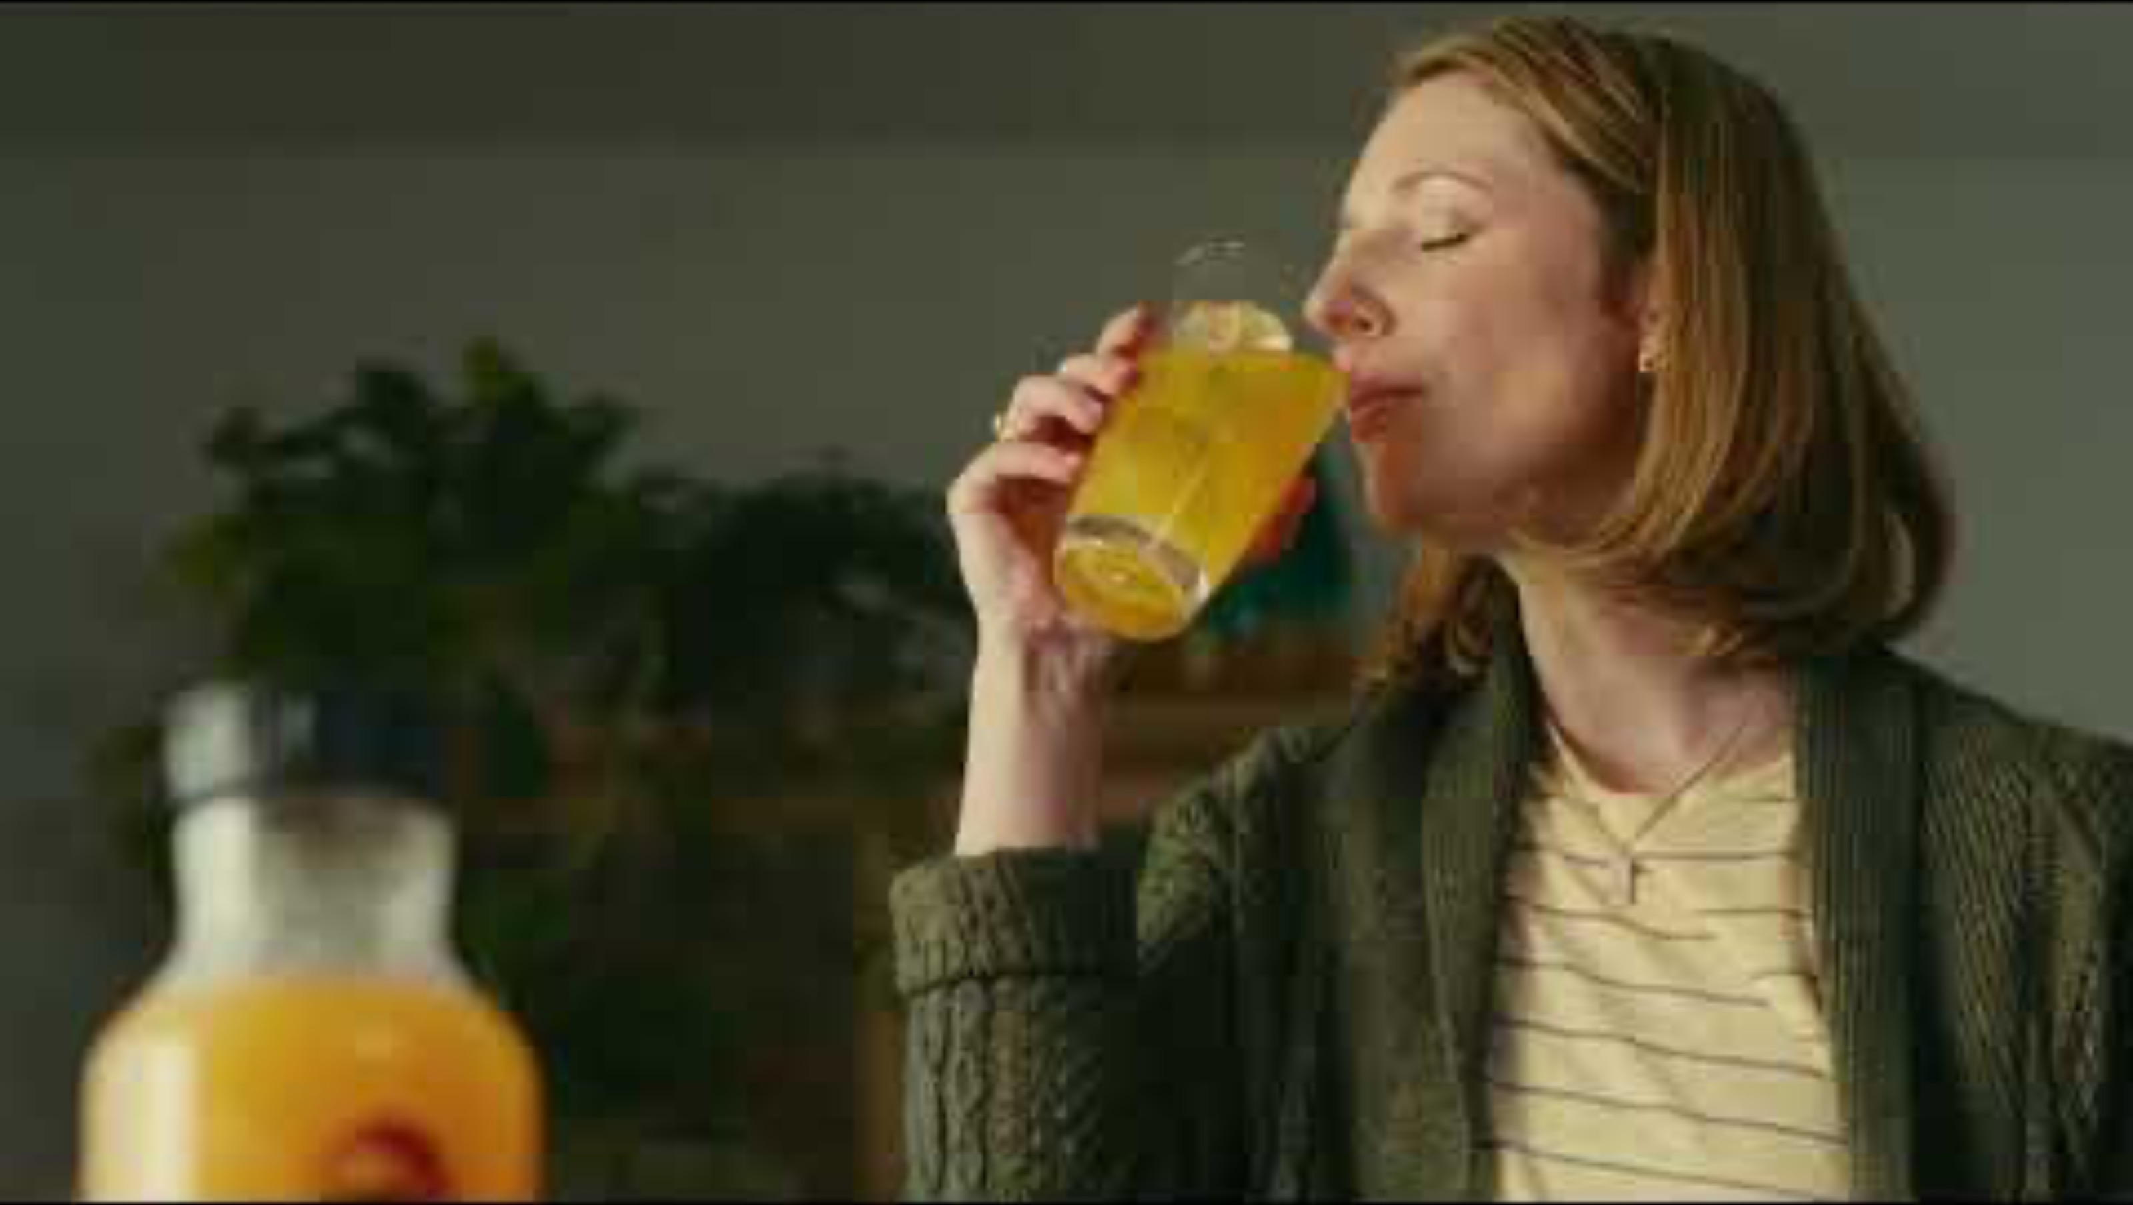
MINUTE MAID’S CURRENT MESSAGE
Ramzi
Link
Notes:
Restyled from the supplied BCOM Presentation 3.pdf. Original slide 10.
The PDF contains a static preview only. Reinsert the original Minute Maid Zero Sugar video.

Slide 11
OPPORTUNITIES FOR MINUTE MAID
01
Influencer partnerships
Partner with influencers to create viral campaigns.
02
Lifestyle branding
Feature Minute Maid in consumers’ daily lives.
03
College partnerships
Partner with college students in exchange for content.
Abby
Notes:
Restyled from the supplied BCOM Presentation 3.pdf. Original slide 11.

Slide 12
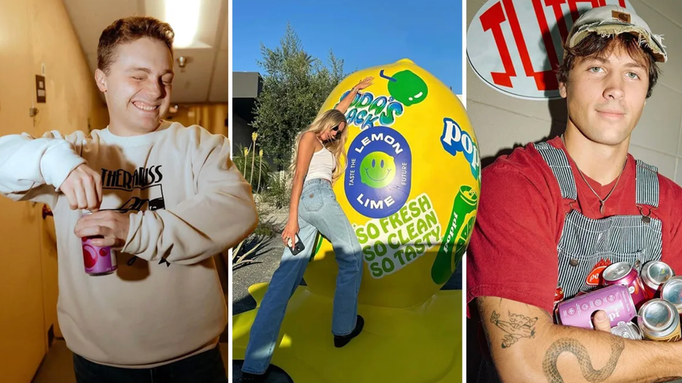
INFLUENCER PARTNERSHIPS
90%
of Gen Z consumers say social media content influenced a purchase in the past six months
Source: Sprout Social, 2025
Abby
Notes:
Our first recommendation is for Minute Maid to strengthen its connection with Gen Z through influencer partnerships and engaging ad campaigns.
A great example of this is Poppi’s Super Bowl commercial featuring popular influencers Alix Earle, Jake Shane, and Love Island star Rob Rausch.
as you watch comapre o MM
[Play video]
What stands out about this commercial is that Poppi isn't just selling a drink. They're promoting a fun, energetic lifestyle that younger consumers want to be part of.
According to Sprout Social, 90% of Gen Z consumers say social media content has influenced a purchase within the past six months, highlighting just how powerful this strategy can be -
And even further highlighting the disocnnect minute maid has with gen z consumers with the boring ad previosuly shown.
Minute Maid has an opportunity to follow Poppi’s approach by moving beyond traditional advertising and partnering with influencers who naturally incorporate its products into their content. This would help modernize Minute Maid’s image, increase brand relevance.

Slide 13
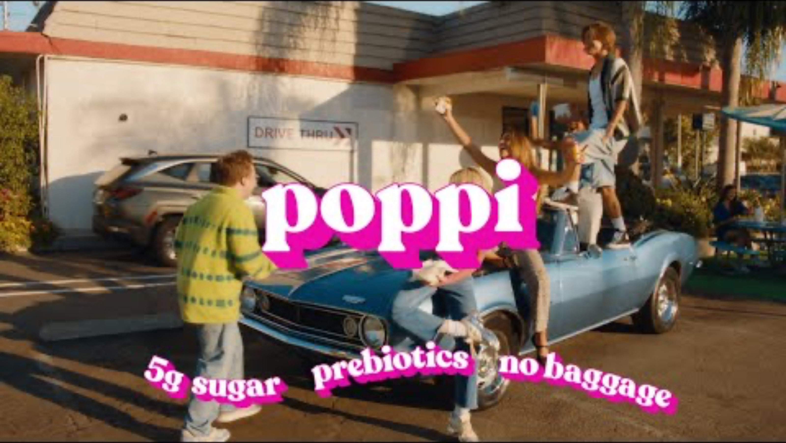
INFLUENCER PARTNERSHIPS
Abby
Link
Notes:
Our first recommendation is for Minute Maid to strengthen its connection with Gen Z through influencer partnerships and engaging ad campaigns.
A great example of this is Poppi’s Super Bowl commercial featuring popular influencers Alix Earle, Jake Shane, and Love Island star Rob Rausch.
as you watch comapre o MM
[Play video]
What stands out about this commercial is that Poppi isn't just selling a drink. They're promoting a fun, energetic lifestyle that younger consumers want to be part of.
According to Sprout Social, 90% of Gen Z consumers say social media content has influenced a purchase within the past six months, highlighting just how powerful this strategy can be -
And even further highlighting the disocnnect minute maid has with gen z consumers with the boring ad previosuly shown.
Minute Maid has an opportunity to follow Poppi’s approach by moving beyond traditional advertising and partnering with influencers who naturally incorporate its products into their content. This would help modernize Minute Maid’s image, increase brand relevance.

Slide 14
MINUTE MAID AS A LIFESTYLE BRAND
157 BILLION+
Day-in-the-life content
Views on TikTok’s #GRWM videos
Feature Minute Maid naturally in influencers’ daily routines.
Accumulated by November 2023
Fortune, November 27, 2023
Abby
Notes:
2.Our second recommendation is to position Minute Maid as a lifestyle brand by incorporating its products into influencers’ everyday routines.
Gen Z frequently engages with ‘day in my life’ videos on TikTok, where influencers share their daily activities, favorite products, and social experiences.
We can see the direct influnce of these get ready with me videos as the hashtag has reached over 157 billion views, accoridng to forbes. This is an oppurtunity for brand recognition that minute maid should not miss out on.
By featuring Minute Maid in these videos, whether they're getting ready for class, going out, or spending time with friends, influencers could introduce the brand in a more natural and relatable way.
This would help Minute Maid move beyond its traditional breakfast image, create more opportunities for consumption while also working to modernize and expand Minute Maids image”

Slide 15
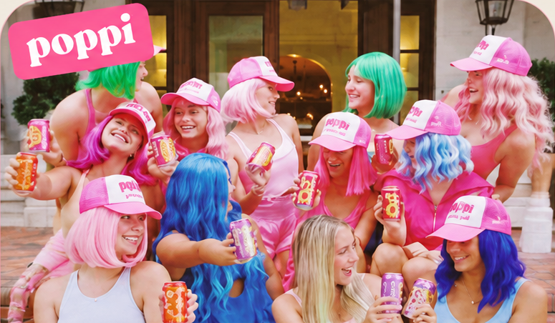
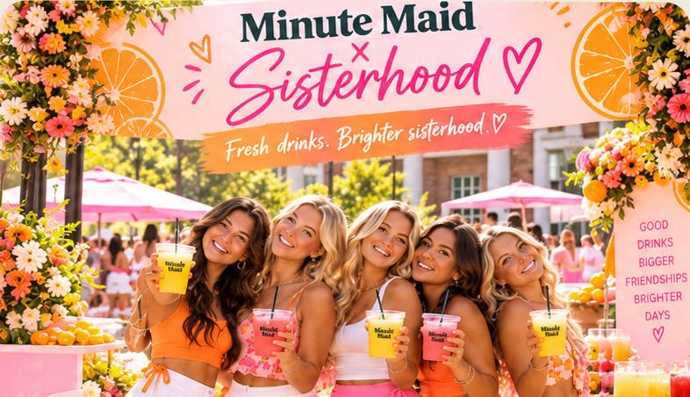
BRAND OPPORTUNITIES WITH GEN Z
POPPI’S CAMPUS STRATEGY
MINUTE MAID’S OPPORTUNITY
2,000
Campus influencer appearances
Product sampling and social sharing
Partner with sororities
Distribute branded PR packages
Encourage TikToks and Instagram stories
Sorority partnerships
nationwide
Poppi LinkedIn
Abby
Notes:
Our third recommendation is to connect Minute Maid’s campaigns directly with Gen Z consumers through sorority partnerships and PR packages.
While gaining views and engagement on social media is valuable, the ultimate goal is to turn that attention into increased sales and brand recognition.
And what better way to introduce consumers to a product than by letting them try it for free?
Minute Maid could follow Poppi’s approach, which included partnerships with 2,000 sororities nationwide, providing free products and encouraging social media engagement.
This presents a strong opportunity for Minute Maid to connect directly with college students by sending PR packages to influencers and athletes, as well as sponsoring sorority events.
By doing so, Minute Maid could encourage students to share TikToks, Instagram stories, and other content featuring its products.
This would not only reach students attending these events but also extend the brand’s exposure to their social media followers. and ultimately reel in our valued gen z stakeholders.

Slide 16
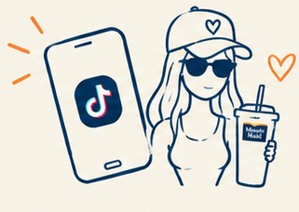
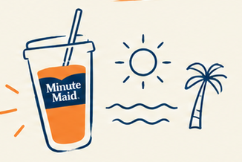
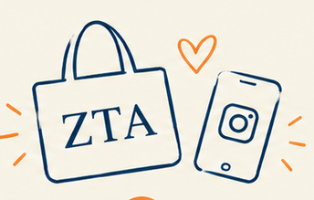
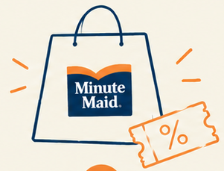
CAMPAIGN TIMELINE
MONTHS 1–3
MONTHS 2–5
MONTHS 4–7
MONTHS 6–12
Influencers &
TikTok campaigns
Lifestyle brand
Sororities & PR
Drive sales
Shelby
Notes:
Restyled from the supplied BCOM Presentation 3.pdf. Original slide 15.

Slide 17
KEY PERFORMANCE INDICATORS
+5 pts
350K
12%+
+200%
Current ~8% · Poppi ~15%
Gen Z consideration
Instagram followers
Engagement rate
PROPOSED OUTCOMES
100K new customers
$2M retail sales
Jay
Notes:
To determine whether our communication strategy is actually working, we identified three primary KPIs focused on Gen Z.
Our most important KPI is a five-percentage-point increase in consideration among Gen Z. This directly connects to the communication problem we identified. It’s not enough for younger consumers to simply see Minute Maid content. We want more of them to actually consider Minute Maid when making a beverage purchase. We would measure this through pre- and post-campaign consumer research.
Our second goal is to grow Minute Maid’s Instagram following to 350,000 followers, which would be approximately a 200% increase from its current following. This would indicate that the campaign is not only reaching younger consumers, but building an audience that Minute Maid can continue communicating with after the campaign ends.
Our third KPI is increasing engagement on Instagram and TikTok from roughly 8% to above 12%. We used Poppi as a benchmark here because its engagement is around 15%. We’re not expecting Minute Maid to immediately match Poppi, but we believe 12% gives us an ambitious and measurable target.
Finally, we wanted to connect these communication outcomes to a potential business impact. In a conservative scenario, we estimate approximately 100,000 incremental customers. If those customers make roughly four purchases during the year at an average retail purchase of about $5, that would generate approximately $2 million in incremental retail sales.
The $2 million figure is an estimate rather than a guaranteed return, but it gives us a way to evaluate whether stronger Gen Z consideration and engagement ultimately translate into business results.”

Slide 18
CAMPAIGN BUDGET ALLOCATION
Content
Production
$100K
Measurement
& Analytics
Research &
Testing
$40K
$40K
Paid Social
Media
Influencer
Partnerships
$400K
$350K
Contingency
$20K
Staff &
Management
$50K
TOTAL INVESTMENT: $1 MILLION
Jay
Notes:
For implementation, we're proposing a $1 million budget for the yearlong campaign. The majority of that investment goes directly toward reaching and engaging younger consumers.
Our largest expense is $400,000 for paid social media, or about $33,000 per month. This would support consistent paid distribution across platforms like TikTok, Instagram, and YouTube rather than relying only on organic reach.
We allocated another $350,000 to influencer partnerships. Based on our research into creator pricing, we estimate roughly $5,000 to $10,000 per sponsored piece of content depending on the creator. This gives Minute Maid the flexibility to work with multiple creators throughout the year rather than relying on a single influencer.
$100,000 goes toward content production, or roughly $8,000 per month, to actually develop the videos, photography, graphics, and other campaign materials that would run across these platforms.
We then allocated $40,000 for research and testing at the beginning of the campaign. This would help Minute Maid establish baseline measurements for things like Gen Z consideration and test which messages resonate before fully launching the campaign.
Another $40,000 goes toward measurement and analytics. This happens throughout and after the campaign so we can compare our results against those original baselines and determine whether we actually reached the KPIs we established.
we've included $50,000 for staff and campaign management
Internal communications/marketing staff time, Creator coordination, Content approvals, Campaign management, Represents employee time diverted to campaign
$20,000 as a contingency for unexpected expenses.
Overall, we believe $1 million is a feasible investment for a yearlong campaign
The scale of Coca-Cola's marketing resources makes a $1 million targeted investment financially feasible, but our recommendation isnt based on the fact that they can launch this campaign bc they have the money it is based on the opportunity to build long-term relevance with Gen Z.

Slide 19
CONCLUSION
Build awareness
Drive engagement
Influencer Partnerships
Social Media Presence
Lifestyle Content
College PR
Modernize the brand. Connect with consumers. Drive growth.
Abby
Notes:
To conclude, our recommendations focus on two key opportunities for Minute Maid: building awareness and driving engagement.
First, by partnering with influencers and strengthening its social media presence, Minute Maid can reach younger consumers and
build awareness among a new generation.
Second, through lifestyle content and college PR initiatives, Minute Maid can go beyond simply reaching consumers and become a brand they
actively engage with and incorporate into their everyday lives.
By building awareness and creating meaningful engagement, Minute Maid can strengthen its connection with Gen Z and position itself for long-term growth."

Slide 20
INDEX
01
02
03
Situation/Background/Analysis
Recommendations
Response
Communication Challenge
Consumer Stakeholder
Connecting with Gen Z
Influencers Partnerships
Lifestyle Branding
College Partnerships
Timeline
KPIs
Budget
Notes:
Restyled from the supplied BCOM Presentation 3.pdf. Original slide 19.
Content preserved from source appendix, including Mountain Dew as benchmark company.

Slide 21
SOURCES
  https://www.askattest.com/blog/research/gen-z-food-trends?utm_source
  https://www.mckinsey.com/industries/consumer-packaged-goods/our-insights/future-of-wellness-trends#/
  https://www.pewresearch.org/internet/2025/11/20/americans-social-media-use-2025/
  https://www.fmi.org/blog/view/fmi-blog/2026/09/11/grocery-shopper-generational-splits-in-beverages-purchase
  https://www.fooddive.com/news/food-is-gen-zs-top-spending-priority-survey-finds/598363/
  https://www.rivaliq.com/blog/good-engagement-rate-instagram/
  https://yougov.com/en-us/articles/55454-us-beverage-rankings-generational-splits-2026
  https://yougov.com/en-us/articles/54479-how-brands-can-reach-gen-z-where-they-spend-time-and-what-drives-discovery
  https://news.keurigdrpepper.com/2025-06-11-Keurig-Dr-Pepper-Unveils-First-Ever-State-of-Beverages-Report
  https://later.com/blog/influencer-pricing-benchmarks-the-complete-2026-guide/
Notes:
https://www.rivaliq.com/blog/good-engagement-rate-instagram/
https://yougov.com/en-us/articles/55454-us-beverage-rankings-generational-splits-2026
https://yougov.com/en-us/articles/54479-how-brands-can-reach-gen-z-where-they-spend-time-and-what-drives-discovery
https://news.keurigdrpepper.com/2025-06-11-Keurig-Dr-Pepper-Unveils-First-Ever-State-of-Beverages-Report
https://later.com/blog/influencer-pricing-benchmarks-the-complete-2026-guide/

